Slide 1




Academic Performance and Stress Factors
Fiona Brockner
Fenella Lachica
Katherine Shagalov

Slide 2
Problem Statement
The intensifying competition in higher education imposes significant pressure on students to excel, which frequently results in adverse consequences. Chronic stress can profoundly affect academic performance and hinder professional achievement.
There are many factors at play such as environmental, psychological, social, and physiological.
Examining how different factors affect academic performance is crucial to help students succeed.

Slide 3
Variable
Description
Data Set
Anxiety | Range from 0-21 (GAD-7)
Self-Esteem | Range from 0-31 (Rosenberg Self Esteem Scale
Mental Health History | 0 if no history, 1 if mental health history
Depression | Range from 0-27 (PHQ-9)
Headache, Sleep Quality, Breathing Problem, Noise Level, Living Conditions, Safety, Basic Needs, Study Load, Student Teacher Relationship, Future Career Concerns, Social Support, Peer Pressure, Extracurricular Activities, Bullying | Range 0-5 0 low - 5 high
Blood Pressure | Range from 1-3
Social Support | Range from 0-3
Stress Level | Range from 0-2
StressLevelDataset.xlsx
21 columns
1100 rows
It contains 20 features that impact stress of student
Task: Use the data set of student stress factors to see how they impact academic performance.
Purpose: To indicate the factors that have the most impact on a student’s academic performance
No preprocessing was needed since there were no empty cells

Slide 4
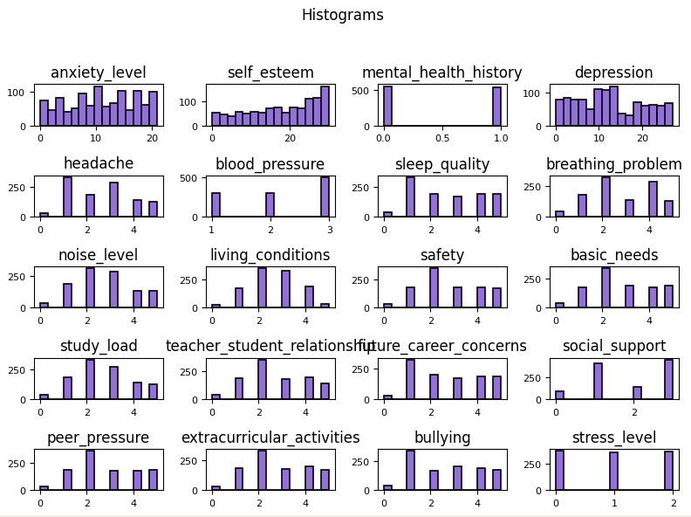

Slide 5
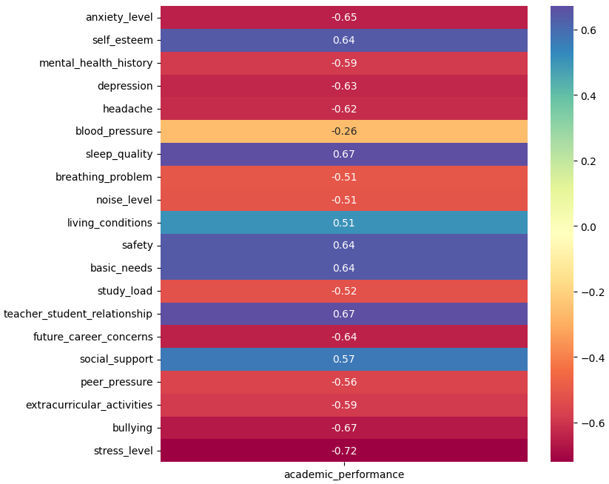

Slide 6
Classifications
1. KNN
2. Naive Bayes
3. CART
4. Random Forest
5. C5.0
6.SVM

Slide 7
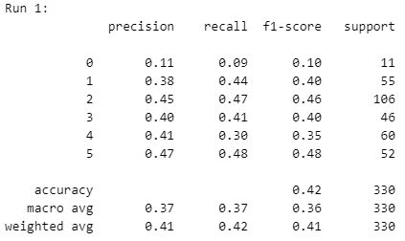
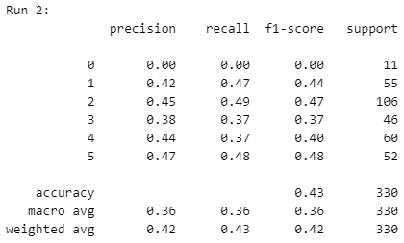
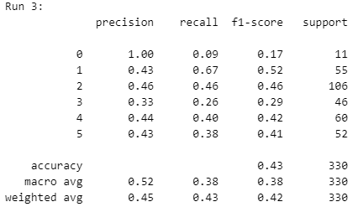
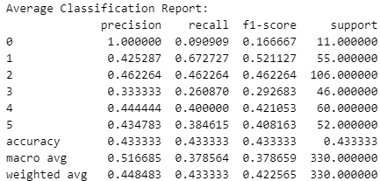
KNN

Slide 8
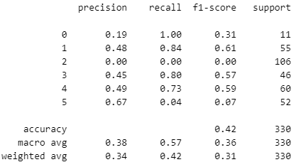
Naive Bayes

Slide 9
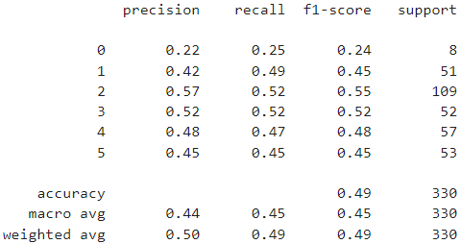
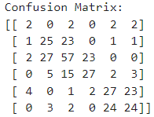
CART

Slide 10

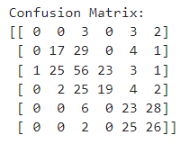
Random Forest

Slide 11
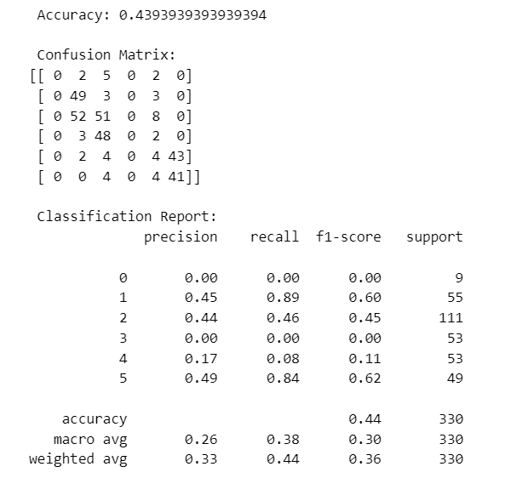
C5.0

Slide 12
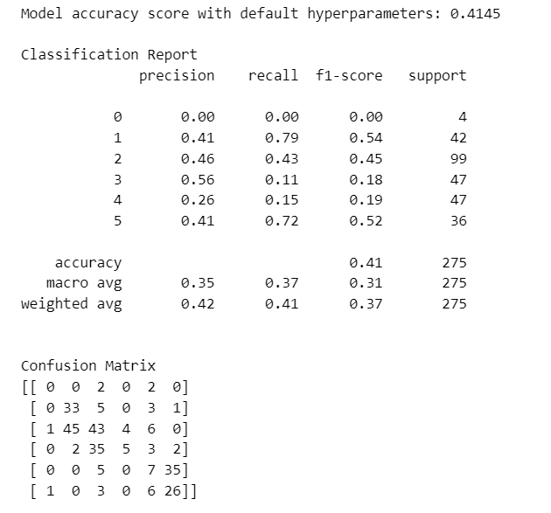
SVM

Slide 13
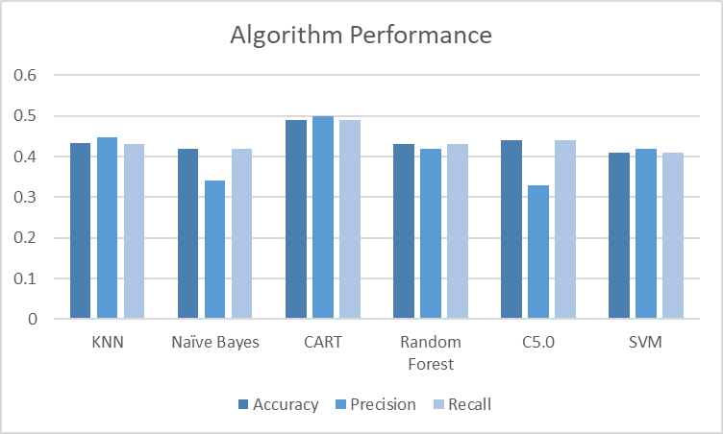
Conclusion
Overall, CART performed the best out of the 6 algorithms.
CART had 49% accuracy

